Slide 1
GIT and GITHUB
By
Juliot Sophia M

Slide 2
GIT
Version control system
Installed in our local machine
Multiple people can collaborate on a project
Track changes in files and directories over time
Revert files or entire projects back to a previous state
Compare changes over time
Repository like Github and Bitbucket can be used along with git

Slide 3
GitHub
Web-based platform
Used along with version control system
Create an account in Github.com
Create a repository

Slide 4
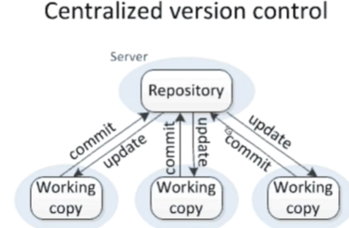
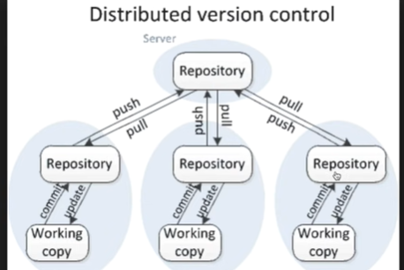
Centralized and Distributed Version control

Slide 5
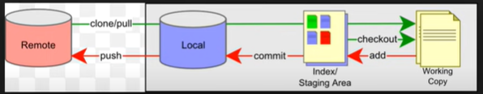
Staging Area

Slide 6
Set Current user
git config --global user.name “current user“
git config --global user.email <email ID>
git config –global core.autocrlf true

Slide 7
Terminologies
Repository (Repo):
A repository is a directory or storage space where all the project's files, history, and metadata are stored. It's the core of version control in Git.
Master/Main Branch:
"Master" is a common default name for the primary branch in a local Git repository
Remote:
A remote is a reference to a Git repository stored on a different server. It allows you to interact with and fetch changes from remote repositories.
Origin:
"Origin" is the default name for the remote repository from which you cloned your local repository.
Branch
Branch is created to work on a specific feature or enhancement. It is branched off from the main branch and merged back when the feature is complete.

Slide 8
Use case 1:Upload a project from Local to Remote repository
Create a Folder in local machine and launch Gitbash
Creates a file Dir> filename.txt
git init –To Initiate empty Git repository in local machine
git status- To get the status
git add . Or git add <file name>-To add all the changes in staging
git rm –cached <file name>-Unstaging(remove a file from staging)
git commit –m “for bug 67890”-To commit with meaningful message
git remote add origin<link of git repository>-to establish a connection between your local Git repository and a remote repository
git push –u origin master-To push the commits from your local master branch to the master branch of the remote repository named origin
git pull –u origin master-To fetch and merge changes from the remote repository (origin) into your local repository's master branch(incorporate changes from a remote repository into your current working branch)

Slide 9
Use case 2:Clone a project from Remote to Local repository
git clone <link of git repository>- Creates a local copy of an entire remote repository
Change to new directory
git branch <branch name>- It allows you to work on different versions of your project simultaneously, without affecting the main or "master" branch
GitHub >>Repository>>Pull requests-Request for review
git checkout <branch name>-Used to switch from current branch to another existing branch
git merge <branch name to be merged>-Combines the changes from another branch into the branch you're currently on and later push command can be used

Slide 10
Use case 3 : Fork the Repository
Login with another github account
Fork the repository(if we don’t have write access to the repository)
Change current user and email details in gitbash
git config --global user.name “current user“
git config --global user.email <email ID>
git branch <branch name>
git checkout <branch name>
Do changes
git add .
git commit –m “updated from fork branch”
git push origin <Fork branch name>
Create pull request from GIThub repository-to get review
Login as owner of the repository and check the corrections made
git checkout master
git merge <Fork branch Name>
git push origin master

Slide 11
Use case 4: Merge Conflict and Resolution
When 2 users update same line of a file and tries to update the remote repository ,Merge conflict occurs

Slide 12
Revert commit & Delete Branch
Revert:
git log -entire commit history, starting with the latest commit at the top
Copy the commit hash
git revert <commit hash> (can be done in any branch)
Git push origin master
Delete Branch
git branch -d branch-name- to delete fully merged branch
git branch -D branch-name - to delete Unmerged branch
git push origin --delete branch-name-to delete a branch from remote repository

Slide 13
Thank You

